Slide 1
FULLSTACK WEB DEVELOPMENT

Slide 2
What is web development ?
Web development, Web development is the process of building websites and web applications. It can include designing, coding, and maintaining websites.
Types of web development :
Front-end development: Focuses on the user-facing side of a website
Back-end development: Focuses on the server-side software that users can't see
Full-stack development: Involves developing both the front-end and back-end of a website

Slide 3
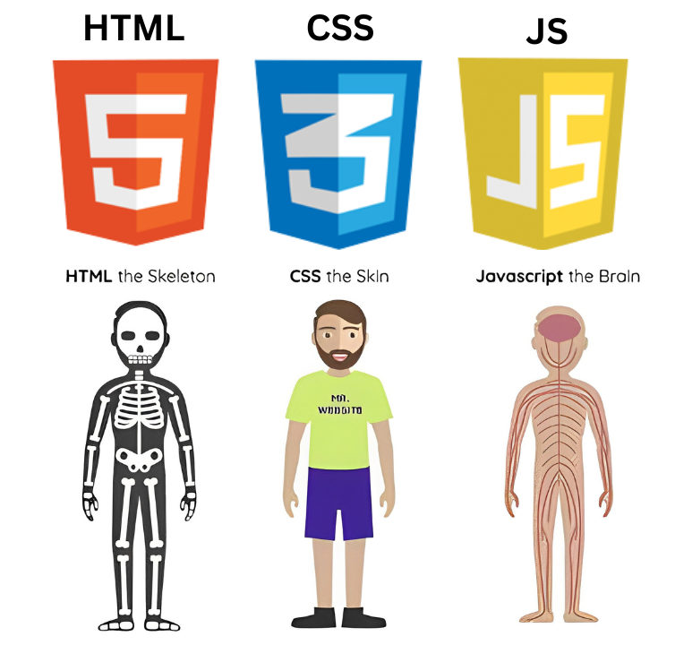
Front-end development:
A front-end developer builds the front-end portion of websites and web applications. The basic languages for Front-End Development are HTML, CSS, and JavaScript.

Slide 4
HTML :
Here are some HTML topic :
HTML Basics : HTML (HyperText Markup Language) is the standard language used to create web pages. It structures content using elements and tags.
HTML Elements : An HTML element is a fundamental building block of a webpage. It consists of a start tag, content, and an end tag.
ex: <h1> to <h6> → Headings
<p> → Paragraph
<div> → Generic container
<section> → Section of a webpage
<article> → Self-contained content
<header> → Header of a page/section
<footer> → Footer of a page
<table> → Table

Slide 5
4. HTML Attributes : Attributes provide additional information about an element.
<a href="https://example.com">Click Here</a>
<img src="image.jpg" alt="Description">
5. HTML Forms: A form is created using the <form> element.
<form action="submit.php" method="POST">
<label for="name">Name:</label>
<input type="text" id="name" name="name">
<button type="submit">Submit</button>
</form>
6. HTML List: HTML Lists
Unordered List : Ordered List :
<ul>
<li>Step 1</li>
<li>Step 2</li>
</ul>
<ol>
<li>Step 1</li>
<li>Step 2</li>
</ol>

Slide 6
7. HTML Links : An HTML link, also known as a hyperlink, allows users to navigate from one web page to another or to a different section within the same web page.
ex:
8. HTML Images: To embed an image in an HTML document
ex: <img src="image-url" alt="description of the image">
9. HTML Responsive Design : HTML responsive design refers to the practice of building web pages that look and function well across a wide range of devices and screen sizes, from desktop monitors to tablets and smartphones. The goal is to ensure that users have a consistent and optimal experience regardless of the device they're using.
<a href="URL">Link Text</a>

Slide 7
CSS :
What is css?
Ans: CSS, or Cascading Style Sheets, is a style sheet language used to describe the presentation of a document written in HTML or XML. CSS is what brings style, layout, and aesthetics to web pages. Here are the key aspects of CSS:

Slide 8
Key Features of CSS:
Selectors – Target specific HTML elements (e.g., .class, #id, element).
Properties & Values – Define styles like color: red;, font-size: 16px;.
Box Model – Consists of margin, border, padding, and content.
Positioning – Methods like static, relative, absolute, and fixed.
Flexbox & Grid – Modern layout techniques for responsive design.
Media Queries – Used for making websites responsive.
Animations & Transitions – Add dynamic effects using @keyframes, transform, transition.

Slide 9
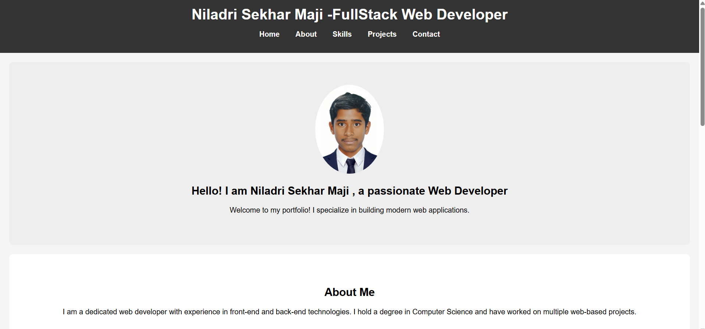
This is my portfolio website using html & CSS : Live link

Slide 10
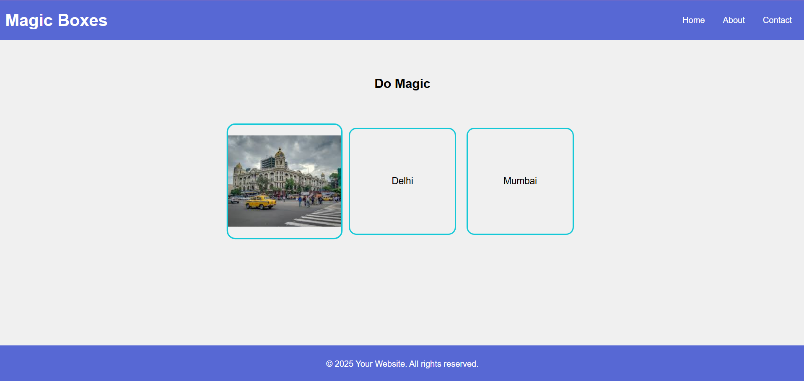
This is Magic box using html & CSS : Live link

Slide 11
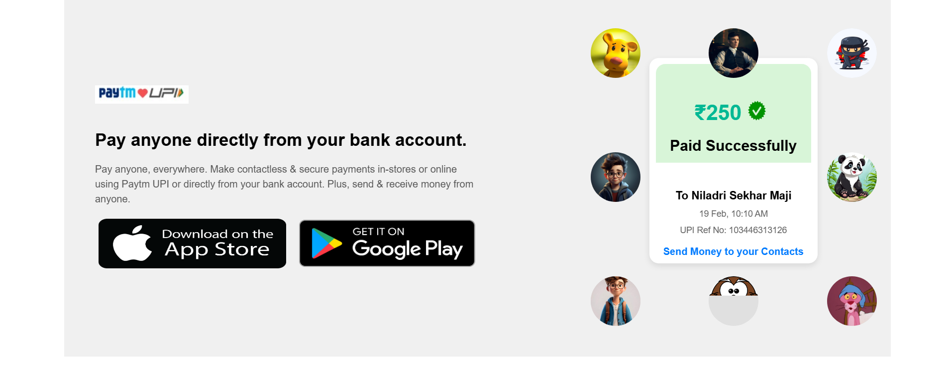
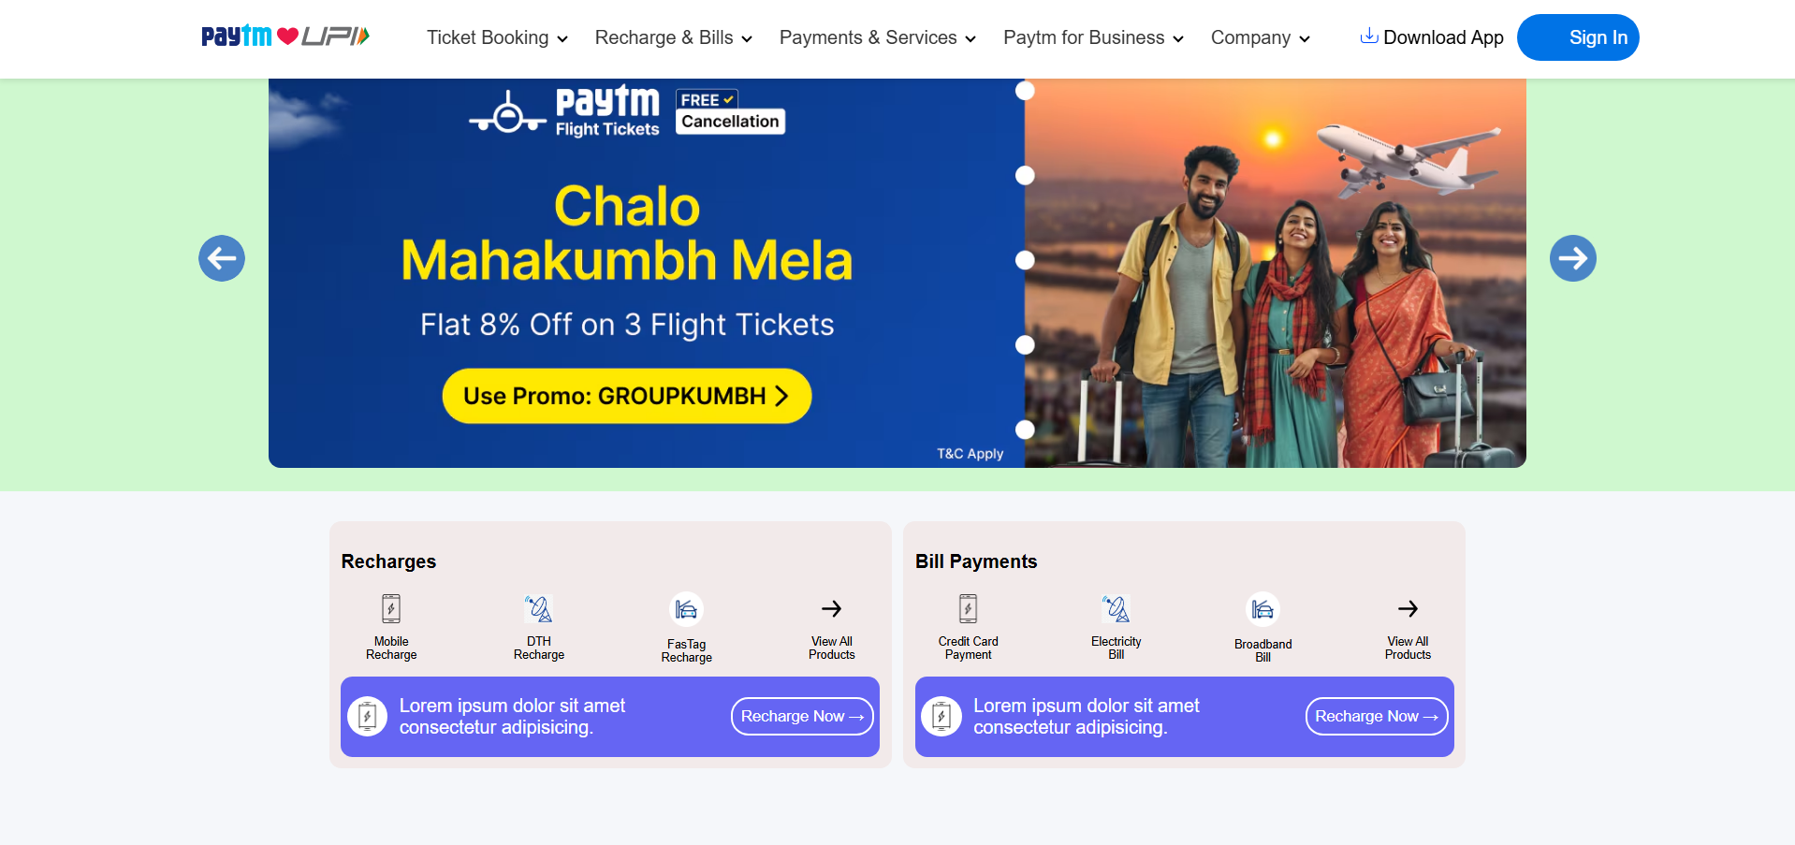
Live link
Live link

Slide 12
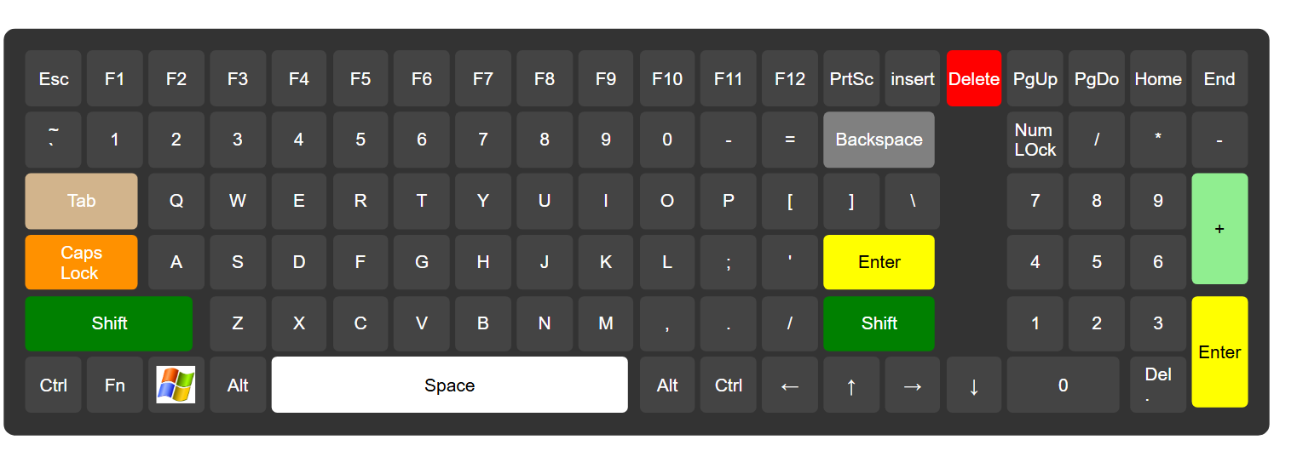
This is keyboard design using html & css :
Live link

Slide 13
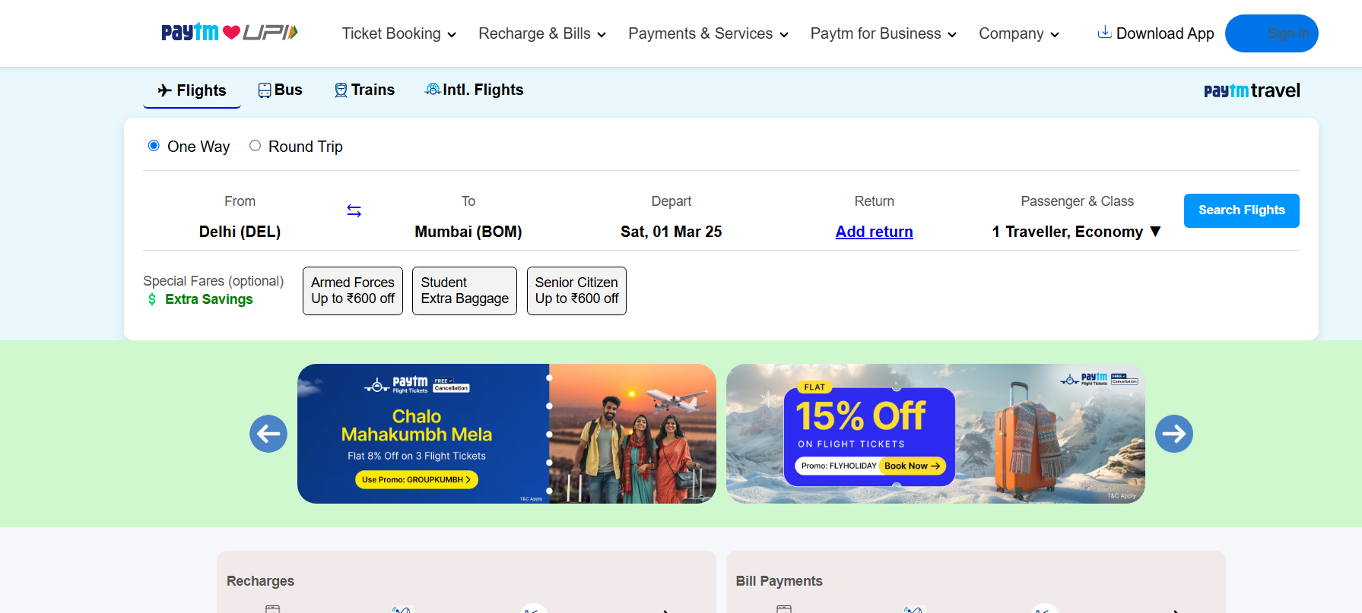
This is Paytm web page using html & css :
Live link

Slide 14
What is JavaScript ?
JavaScript, often abbreviated as JS, is a high-level, dynamic programming language primarily used in web development. It's one of the core technologies of the web, alongside HTML and CSS. Here's a quick overview:
Client-Side Scripting: JavaScript is most commonly used for client-side scripting, which means it runs directly in the user's browser. This allows developers to create interactive and dynamic web pages.
Server-Side Development: With the advent of Node.js, JavaScript can now also be used for server-side development, allowing developers to use the same language for both the client and server sides.
Versatility: JavaScript can be used for a wide range of tasks, from form validation to creating games and complex web applications. It can also be used in conjunction with other web technologies like AJAX to update web pages without reloading. Libraries and Frameworks: There are numerous libraries and frameworks that enhance JavaScript's capabilities, such as React, Angular, and Vue.js for frontend development, and Express.js for backend development.

Slide 15
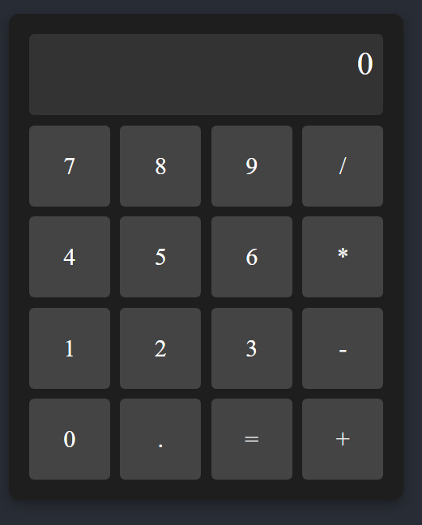
This is calculator using Html,CSS & JavaScript :
Live link

Slide 16
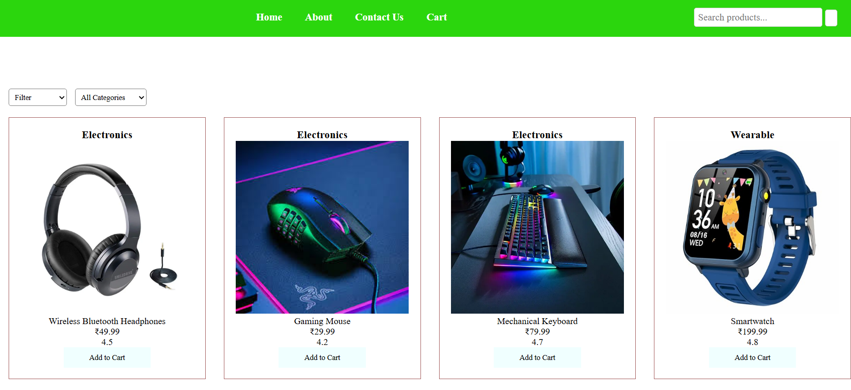

Slide 17
This is my Some projects:
https://nilubhai93.github.io/hospital-managment/
https://nilubhai93.github.io/dashboard/
https://nilubhai93.github.io/pricing-section/
https://nilubhai93.github.io/irctc/
https://nilubhai93.github.io/parallax-effect-website/
https://nilubhai93.github.io/Gmail-Clone/
https://nilubhai93.github.io/my-protfolio/

Slide 18
Thank you…..

